Slide 1
Developing Depression Risk Prediction Models:
Using the National Health and Nutrition Examination Survey Data (2013-2014)
MSCA 31008 Data Mining Principles
Group 2: Bei Wang, Fangyuan Zhao, Kat Hutcheson, Amro Hassan
12/06/21

Slide 2


Agenda
Introduction
Methods
Results
Conclusions

Slide 3
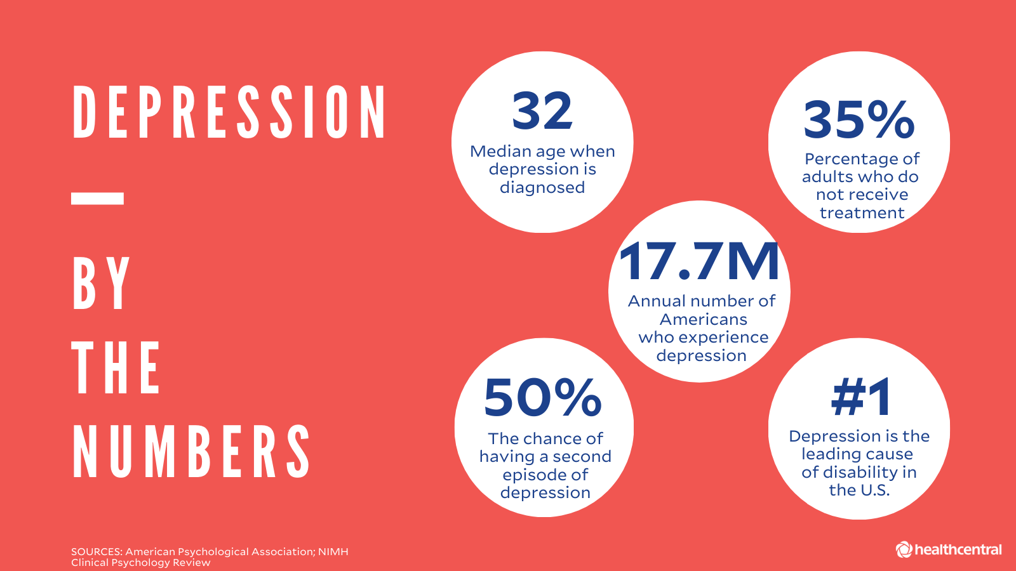

Introduction
Depression has become one of the leading causes of disability
COVID has contributed to the increased risks of depression and has further created challenges in depression screening
Risk factors of depression are multifactorial
Genetics
Lifestyle/behavioral
Socioeconomic status
Environmental/structural

Slide 4

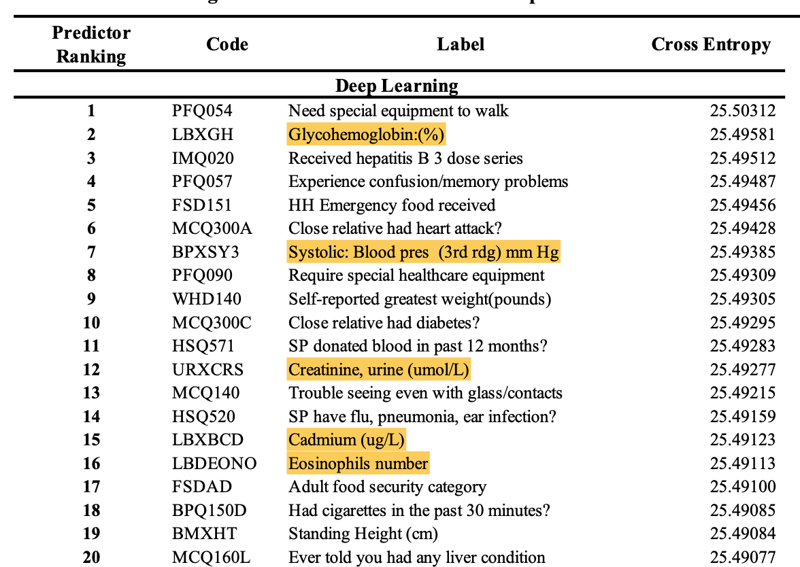
Existing Tools
Standardized questionnaires (e.g. Patient Health Questionnaire PHQ-2 and PHQ-9)
Pros: Validated screening tools
Cons: Sensitive questions, highly subjective
Model built using NHANES (Oh et al., 2019)
Pros: Contains a rich sample of critical demographic, socioeconomic and behavioral risk factors
Cons: Difficult to directly implement in business
157 features - making the replicability and implementation of the model extremely time and resource intensive
lengthy and expensive lab-based tests (e.g. measuring creatinine levels in urine, cadmium, etc)
COVID requires the need for model inputs that can be remotely collected and easy to answer

Slide 5

Problem to Solve
Develop a brief depression prediction tool for social service and healthcare practitioners to screen clients or patients who might be at higher risk, providing opportunities for early intervention and treatment
How?
Considerations
l\The model should include questions that are easy to answer and do NOT require lengthy or in-person data collection
Explore if different racial/ethnic populations require different models
Notes:
Social service and health care professionals are well-situated to assess depression risk of their clients or patients during brief encounters.
But this has been challenging because people who are at higher risk of mental disorders might be reluctant to respond to standardized questionnaires for depression screening (e.g. PHQ-2 and PHQ-9). Moreover, there is no efficient and user-friendly predictive tool for this purpose.

Slide 6



Data Source and Pre-Processing
Data Source: National Health and Nutrition Examination Survey (NHANES, 2013-2014)
Goal: Easy-to-answer questions that do NOT require lengthy or physical data collection in brief health care or social service encounters and does not require lengthy and expensive tests for replication
Include: Sociodemographic, dietary, socio-psychological, behavioral health, medical conditions, functional health, life experience
Exclude: Medications, laboratory tests (biomarkers), and examinations
Data type & transformation
Starting Point
1,166 features
Create Target PHQ-9 >=8
Missingness and Imputation
Feature Selection, Normalization
Resampling Imbalance Target Labels
PHQ-9: Validated measurement of depression
Sum of 9 questions (0-27)
Target:
Dep: PHQ-9 >=8; Non-dep: PHQ-9 < 8
Drop: Obs missing in PHQ-9
Drop: Features missing >20%
Drop: Non-numeric features
Impute: Most frequent values (sklearn.Simpleimputer)
Manual drop irrelevant features: admin-related, duplicates, etc.
Normalization: Remove mean and scale to unit variance (StandardScaler)
Imbalance: More non-dep (majority) than dep (minority)
SMOTE + undersample majority
Remain test set intact to reduce bias
Imputation of missing values
Data for Model Selection
211 features, 5,372 unique observations
‹#›
Notes:
Missingness and imputation
PHQ9:
the NHANES used PHQ9 to measure depression. It’s a widely-used and validated tool for depression.
9 questions asking people to self-rate on a scale of 0-3 how severe they have experienced the 9 depressive symptoms
Range: 0-27
Literature: 8-11 on PHQ-9 is robust to detect major depression disorders. So we dichotomized it in this way to define our target.
There are other thresholds (moderate, severe depression) we have explored (shown in next slides). Some results in small number of depression classification in the target.
feature selection: drop admin related features (language of interviews), features requires lengthy dietary assessment, duplicated questions
normalization: remove the means and scaling to unit variance
resampling:
we have imbalance target classification; way fewer depression (minority) than non-depression (majority).
Synthetic Minority Oversampling Technique (SMOTE) is usually what’s been used to address this problem by creating a synthetic example of the minority class.
We found research suggest that using SMOTE in combination with undersampling the majority class result in better performance.
so we oversample the minority so it’s 0.4 of the majority, and then undersample the majority so it’s 0.5 more than the minority.
keep test set intact

Slide 7
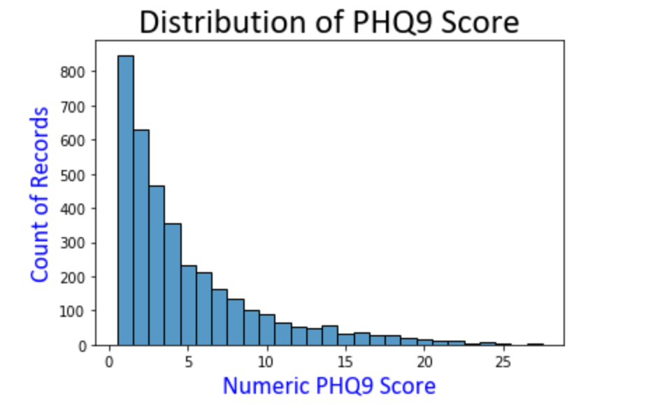
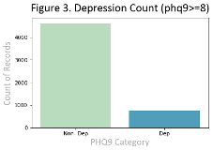
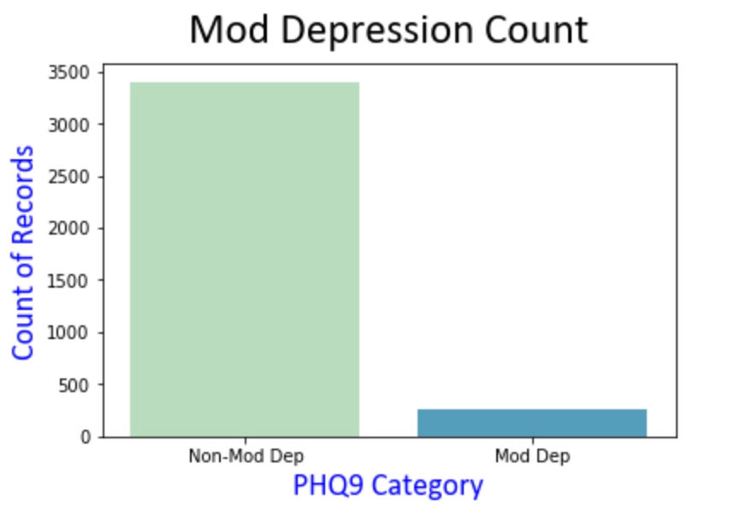
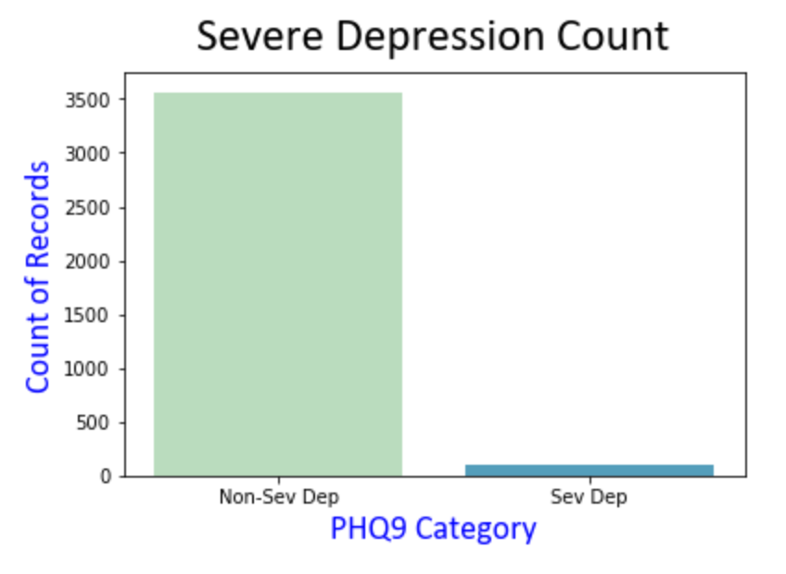
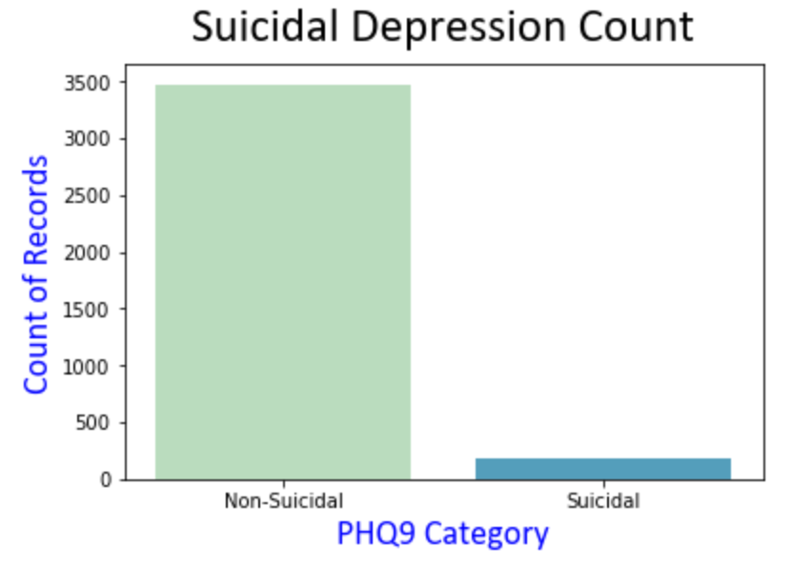
Explore the Target Variable
phq9 >= 20
phq9 >= 15
Developing Depression Risk Prediction Models for Different Populations
‹#›
Notes:
We looked at the target variable in a few different ways:
the first graph shows its distribution as a continuous variable
the figure 3 graph is what we used in our project. We can see this gives us considerable depression classifications. this phq9>=8 is also research-supported.
the severe dep, suicidal, moderate dep graphs show that very few classification by these difinitions (too few cases to accurately predict in a model)

Slide 8
Model Selection
Feature Selection with Gradient Boosting
Model Selection Process
Supervised Learning Algorithms
XGBoost: Top 20 features with the highest importance to proceed to model selection
Importance: “How useful or valuable each feature was in the construction of the boosted decision trees?”
Importance score was calculated within each decision tree by the amount that each attribute split point improves the performance measure and then averaged.
40% of the data was set aside as the test set (with stratify)
Training set:
Repeated 10-folds cross-validation
Mean accuracy score
Mean Receiver Operation Characteristics (ROC) Area Under Curve (AUC) scores
Retrain the best model:
Fit the best model using the full training set
Test set (N=2149):
Evaluate best model’s performance using ROC AUC score
Baseline models:
Logistic Regression
Decision Tree
Ensemble methods:
Random Forests (bagging)
Adaptive Boosting
Gradient Boosting
Hypertuning parameters:
Gridsearch
Developing Depression Risk Prediction Models for Different Populations
‹#›
Notes:
The AUC score is a more unbiased estimate for imbalance classification like ours (Brownlee, 2021)
after the model with the highest AUC was selected, we retrained the model using the full training set.
the last step was to evaluate this model in the test set, which was never used in the training process.

Slide 9
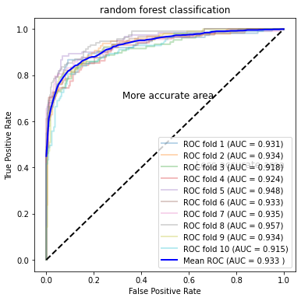
Results: Identify the Best Model
ROC AUC of the random forest model with 10-folds cross validation
Model performance in training set with 10-fold cross validation
Model Name | Accuracy (sd) | Mean AUC (with 10-fold cross validation)
Baseline model
Logistic Regression | 0.778 (0.017) | 0.825
Decision Tree | 0.857 (0.017) | 0.874
Tree-based ensemble classification models
Random Forest | 0.885 (0.009) | 0.933
AdaBoost | 0.889 (0.012) | 0.929
Gradient Boosting | 0.887 (0.011) | 0.929
XGBoost | 0.883 (0.014) | 0.917
Notes:
accuracy scores are pretty close for the ensemble methods, the random forest has the highest mean AUC.
the plot on the right shows the 10-folds cross validation results of the random forest model.

Slide 10
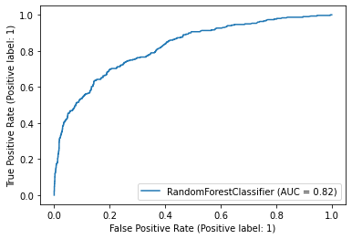
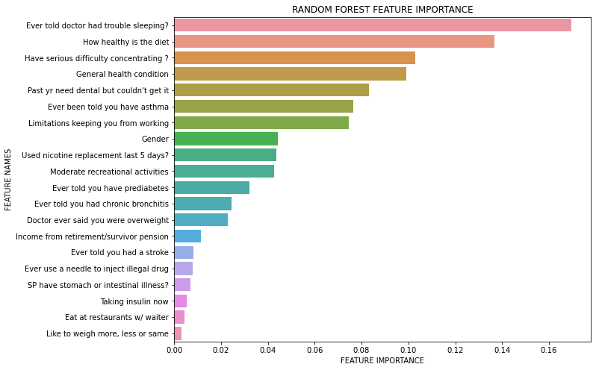
Results: Evaluate the Best Model
ROC AUC of the random forest model in test set (AUC=0.82)
Feature importance plot of the random forest model
Notes:
showing the performance of the final model in test set.
Our final best model has an AUC of 0.82. In general, 0.7 to 0.8 is considered acceptable, 0.8 to 0.9 is considered excellent, and more than 0.9 is considered outstanding. This also meets with our goal of developing a model with an AUC no smaller than 0.8.
Feature importance of the final model is presented in the graph below. We can see that sleep, behavioral health, functional health, and medical conditions play important roles in predicting depression.

Slide 11
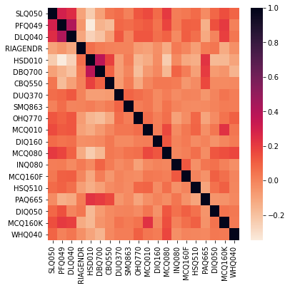
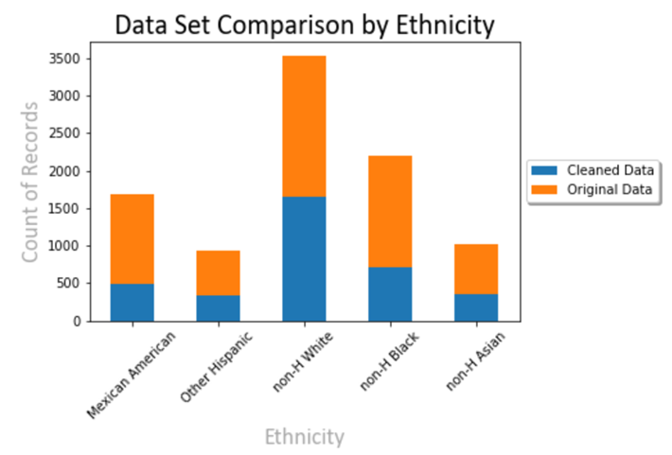

Conclusion & Limitations
Conclusion
We used supervised learning methods to develop a 20-item predictive model for depression with satisfactory prediction performance (AUC= 0.82)
Administered within several minutes
No in-person assessment or data collection needed
Assist healthcare and social service practitioners to identify people at higher risk of depression (esp. during the pandemic)
Limitations
Our model is subject to multicollinearity (the heatmap)
Imbalance classification in target leads to fewer true positives, reducing our model’s sensitivity and usefulness
Resampling can induce bias
Insufficient data to detect racial/ethnic differences:
Non-Hispanic White respondents made up 38% of final data set, while other ethnicities were less represented
Non-white groups got greater proportions of missingness
Developing Depression Risk Prediction Models for Different Populations
‹#›

Slide 12
Questions?

